Slide 2
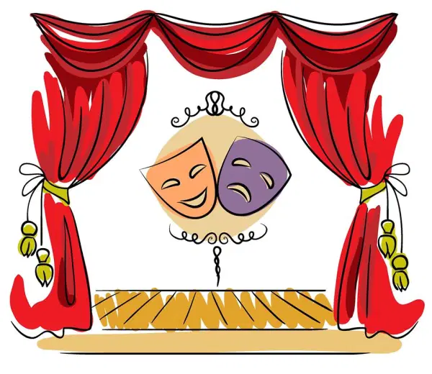
Learning Objectives:
I can imitate the
sound and movements
of things.
I can pretend to
be a character in a story.
Vocabulary:
Character: person animal,
or object in a story.
Imitate: copy or reproduce
voice or movement qualities.

Slide 3
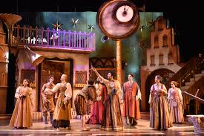
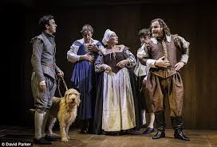
What is Drama?
Drama is the art of creating and putting on plays

Slide 4
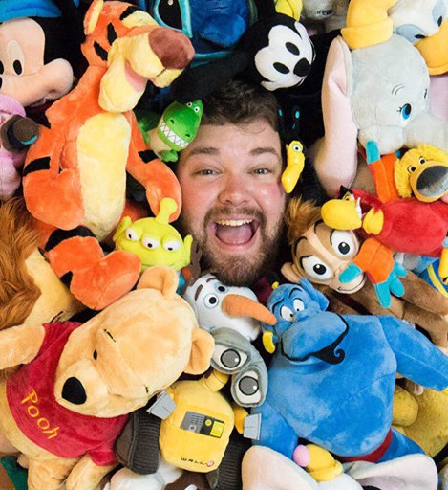
Character Voices:
Watch this skilled actor change his voice to create 100 different character voices in under 4 minutes!
https://www.youtube.com/watch?v=rV9odpHu7to

Slide 5
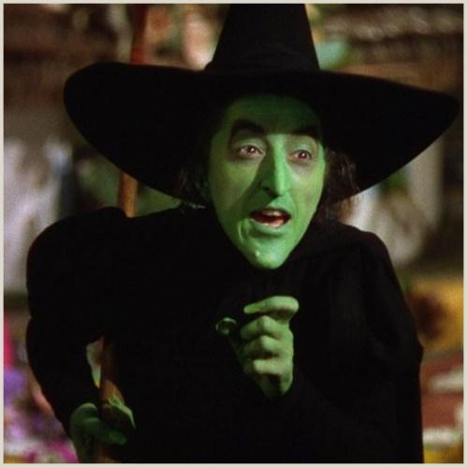
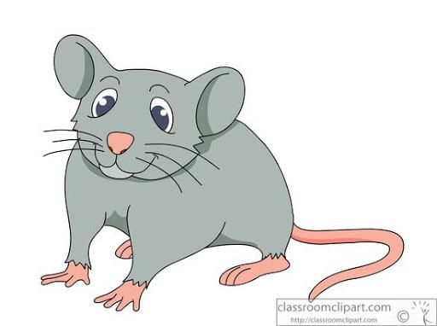
Now you try!
Read the following lines and try to change your voice to sound how you think the character might sound:
Character | Line
Mouse | “Oh no! Please don’t eat me, I can help you!”
Big Bad Wolf | “I’ll huff, and I’ll puff, and I’ll BLOW your house down!
Wicked Witch | “I’ll get you my pretty, and your little dog too!!!”
Cowboy | “ I reckon this town ain’t big enough for the two of us……”

Slide 6
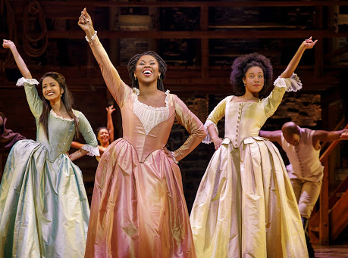
Body
Actors can change the way they stand, move and walk to create a character.
A wealthy or confident character might walk very tall and proud.
A shy character or an old character might walk hunched over.
A goofy and silly character might have a bounce in their step when they walk.

Slide 7
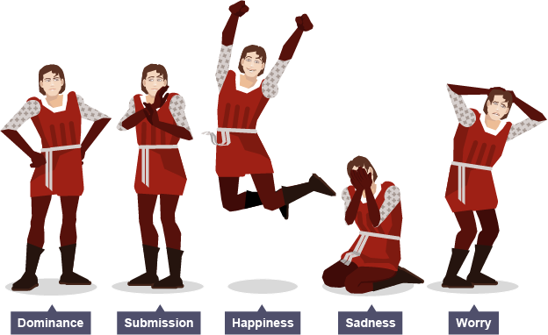
Changing your body:
Now you try! Follow along with the video below and see some different ways you can change your body to create a character!
https://www.youtube.com/watch?v=hjjaT8AIQI0

Slide 8
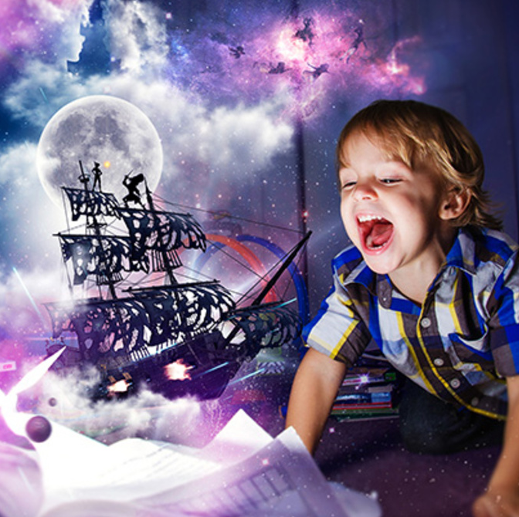
Imagination:
Before you can create a character, you must be able to imagine what that character is like.
How does your character walk? How do they talk? How does you character feel about different things? What are their likes and dislikes?

Slide 9
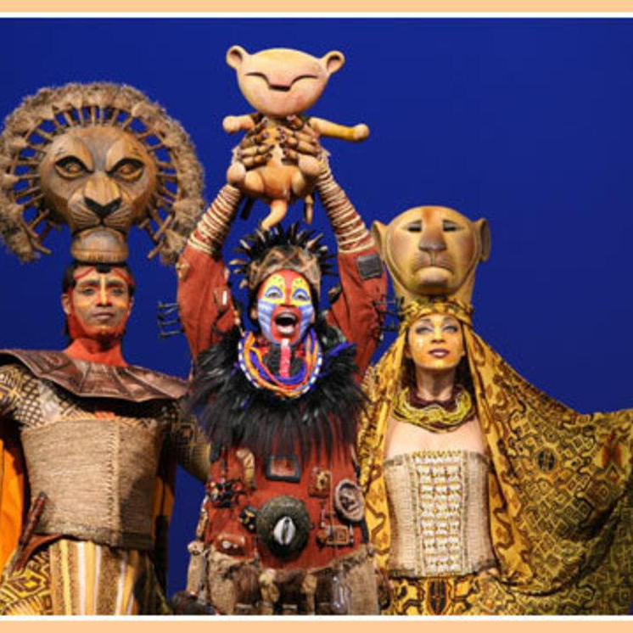
THE LION KING
Click on the link below to watch these actors from Disney’s The Lion King on Broadway and see how they use their imagination to create their characters.
https://www.youtube.com/watch?v=QvPvzCNegC8

