Slide 1
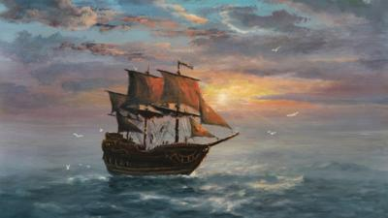
Sea Shanty Songs
5th Grade / Music / Week 31

Slide 2
Sea Shanties
Sea Shanty songs were simple tunes created by sailors. They were sung on long voyages to help pass the time and improve the morale of the sailors.
The song “The Wellerman” originated from Whalers (fisherman who would fish for whales) off the coast of New Zealand.
The Wellerman refers to the ship that would bring the Whalers supplies. They would be paid for their services in goods that they would need on their ship. (such as sugar, tea and rum)

Slide 3
The Wellerman
The Wellerman became very popular on TikTok when one person posted a video, and then others added their own vocal parts and instruments.
Then people started creating their own versions of this song and other Sea Shanties.

Slide 5
Now sing your harmony along with this song!

Slide 6
Wellerman Harmonies
Songs are made up of melodies and harmonies. The melody is the part that most people sing, and it is the easiest to hear. Harmonies are lower or higher than the melody and make the musical chord sound richer and fuller.
Pick one of these harmonies to learn. Listen to the video several times and practice by singing along.
Once you think you have the harmony memorized, sing along with the song on the next slide.

